Slide 1


Final Presentation
06.07.21
Computational Social Sciences Lab
Supervised by: Prof. Dr. Florian Lemmerich
SoSe’21

Slide 2
Group Members
Artiola Kuke
Fariha Hossain
Umme Rabab

Slide 3
Group Members
Introduction

Slide 4
Agenda
Introduction
Dataset
Research questions
Implementation , Results, Challenges
Future steps
Discussion

Slide 5
Introduction
Problem Statement -
Searching for WGs is cheaper but finding the right flatmate is difficult because of the mentioned preferences and expression of sentiments.
Motivation -
This has motivated us to predict/observe how many advertisements show positive/negative sentiments w.r.t gender, age and LGBTQIA+ preferences.

Slide 6
Group Members
Dataset

Slide 7
Dataset
Given a page, received all 20 listings in that page.
Download the website locally, in case it changes.
Data - Name, Title, URL, Die-WG, Gesucht wird, Adresse, Zimmer, Lage, WG-Leben, Sonstiges and Gender.
Gender-API – To determine Gender based on Names.
Supports 189 countries
Accuracy - 98 % on an average

Slide 8
Dataset
A total of 200 advertisements were scraped.
Collected data from Passau and saved to csv file
Collected data from Regensburg and saved to csv file
Merged the two datasets using Pandas.
Data cleaning performed.

Slide 9
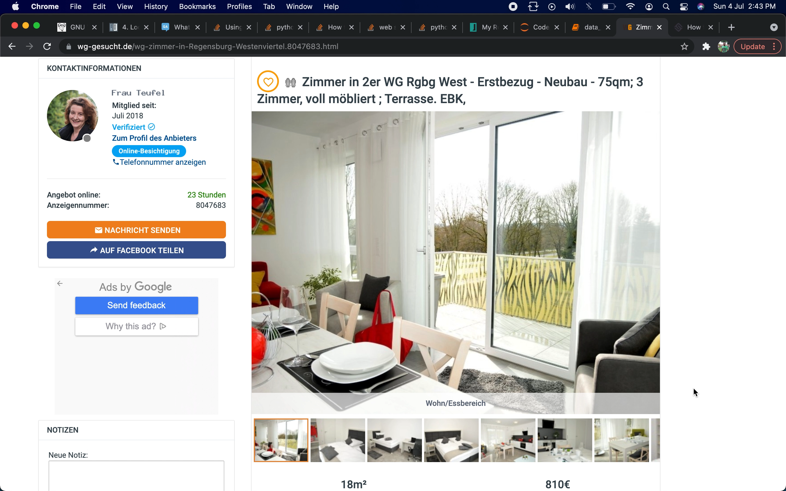

Slide 10
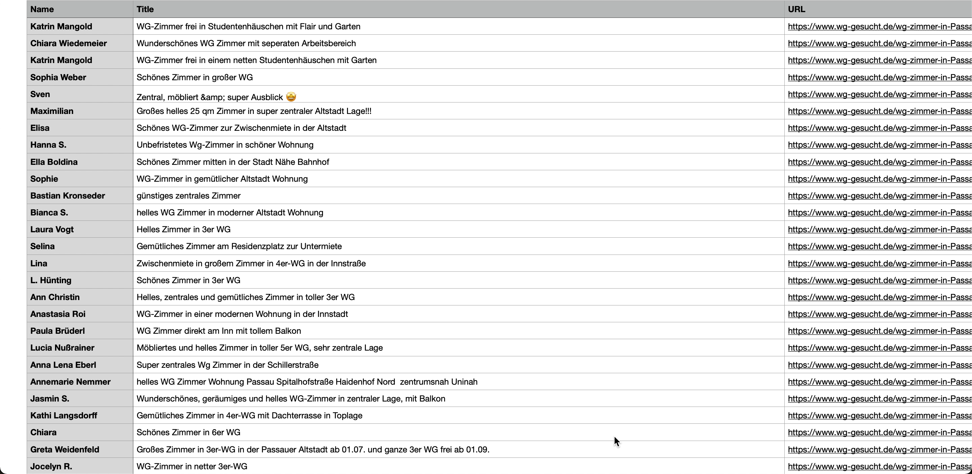
Dataset

Slide 11
Problems in data collection
Irregular HTML structure
Time-out issue while retrieving many webpages at once.

Slide 12
Group Members
Research Questions

Slide 13
Research questions - Q1
Q1 : Comparison of ‘sentiments’ in advertisements listed by a Male and and those listed by a Female.
Fields taken into consideration : Name, Gender, Description (Lage, WG-Leben and Sonstiges)

Slide 14
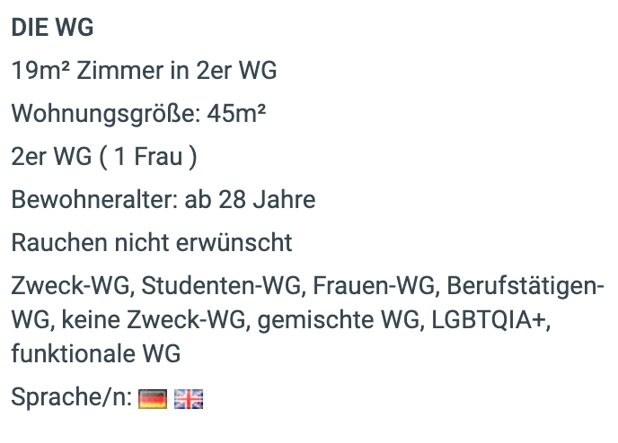
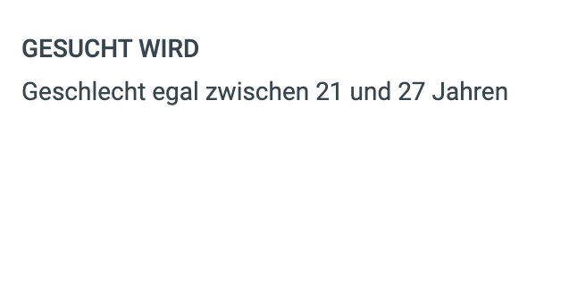
Research questions - Q2
Q2 : How many advertisements welcome LGBTQIA+ and age preference?
Fields taken into consideration : Die-WG, Gesucht wird

Slide 15
Group Members
Q1 - Comparison of ‘sentiments’

Slide 16
Implementation - Q1
Sentiment Analysis
Used textblob_de package for the German texts.
Application on the Description texts (Lage, WG-Leben and Sonstiges).
Polarity (emotions expressed in a sentence) was calculated.
Plotting the gender against the sentiment scores.

Slide 17
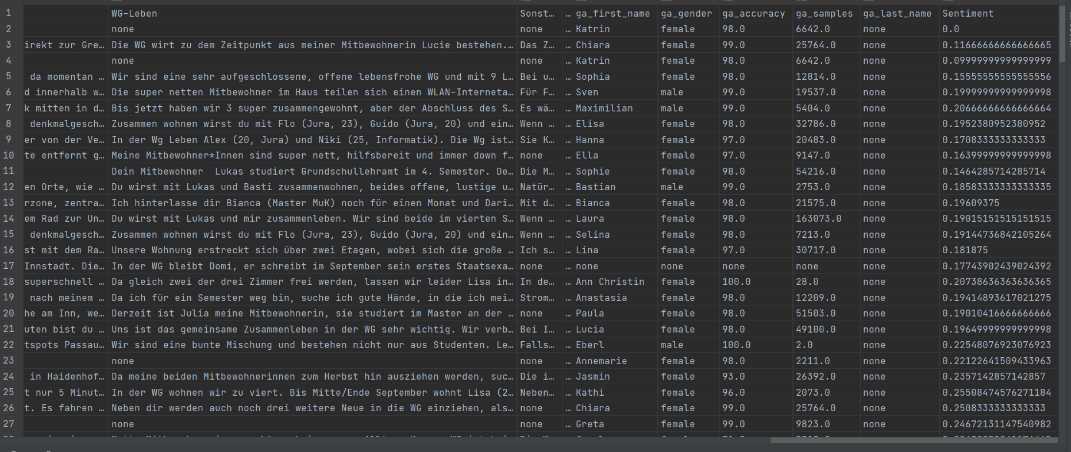
Dataset - Q1 Sentiment Analysis
Dataset showing sentiments(Polarity scores)

Slide 18
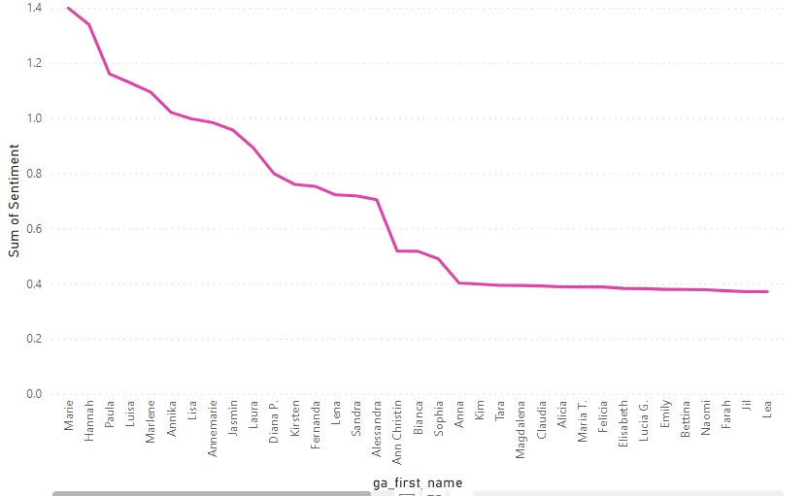
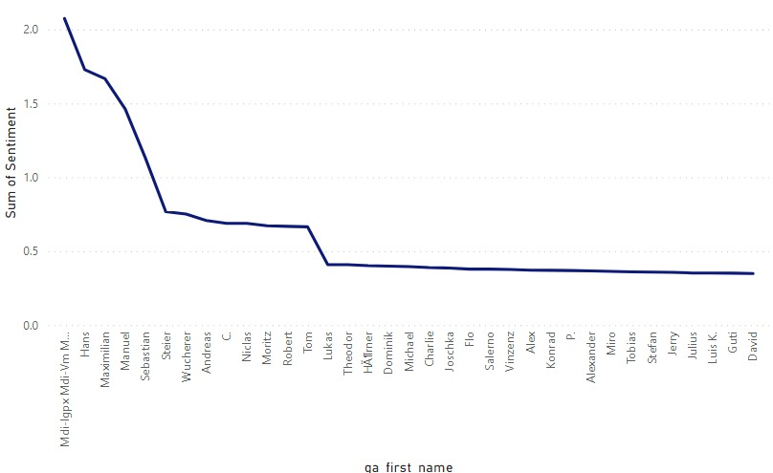
Results – Q1
Female
Male

Slide 19
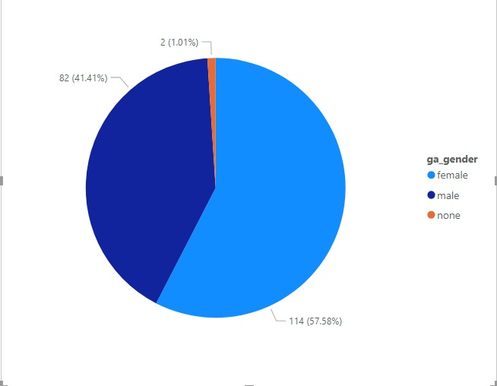
Results – Q1

Slide 20
Problems – Q1
Problems encountered during analysis - Missing data gave value 0.0, so couldn’t consider this value.
Limited support for German language regarding sentiment analysis

Slide 21
Group Members
Q2 - LGBTQIA+ and Age preference

Slide 22
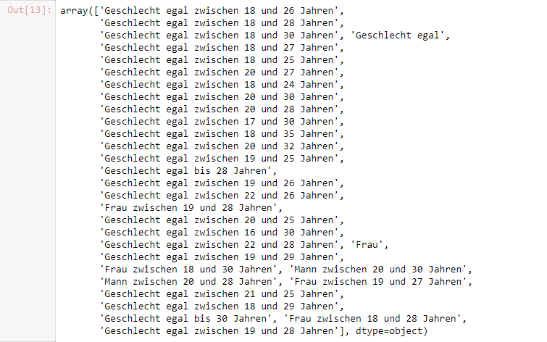
Implementation - Q2 Linear Regression

Slide 23
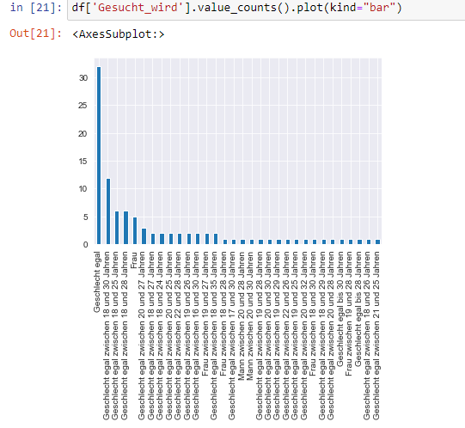
Data Visualization:Gender Requirement

Slide 24
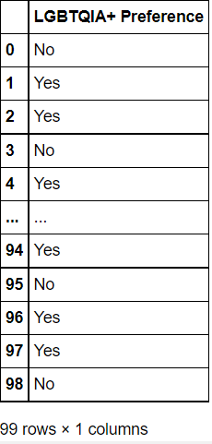
Dataset - Q2 (LGBTQIA+ Preference) Linear Regression

Slide 25
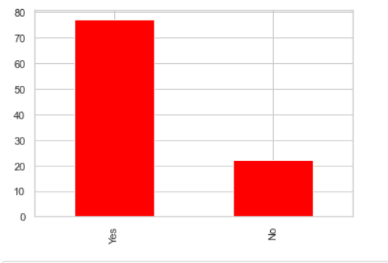
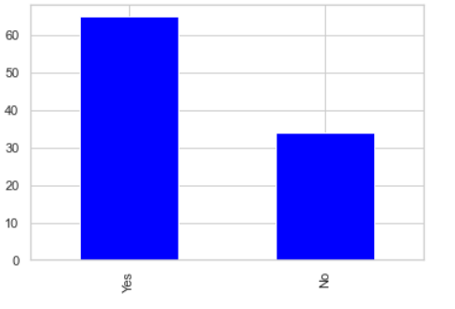
Results -Q2
Passau
Regensburg

Slide 26
Dataset - Q2 (Age Preference) Linear Regression
Linear regression is a basic and commonly used type of predictive analysis.
The overall idea of regression is to examine two things:
(1) does a set of predictor variables do a good job in predicting an outcome (dependent) variable?
(2) Which variables in particular are significant predictors of the outcome variable, and in what way do they–indicated by the magnitude and sign of the beta estimates–impact the outcome variable?

Slide 27
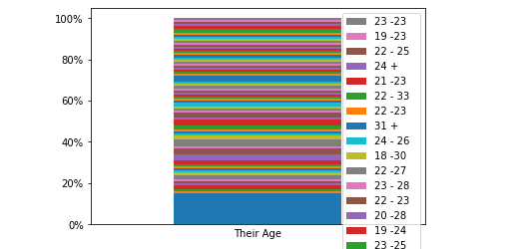
Result - Q2 :Diversity of intervals
(age preference)

Slide 28
Problems – Q2
Inconsistency in data
Applying Random Forest was not possible.

Slide 29
Group Members
Future steps

Slide 30
Future steps:
Expand the dataset with listings from other cities.
Automating the scripts further by just entering the preferred City and retrieving all it’s active listings.
The analysis can also be applied on other type of Wohnung advertisements.

Slide 31
Group Members
Conclusion

Slide 32
Conclusion
Based on results in Q1, we predict majority of the male showed negative sentiments compared to female.
Based on results in Q2,we predict that the majority of the advertisements in WG-Gesucht do not require age or gender.
Based on results in LGBTQIA+ graph, we conclude that students are more LGBTQIA+ friendly in Passau compared to students in Regensburg.

Slide 33
Group Members
Thank you!!

